Slide 1
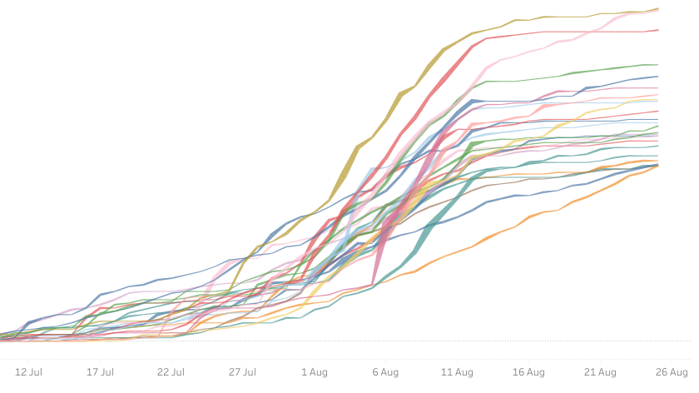
Tracking the Edinburgh Fringe Festival using Twitter, R, & Tableau
Alasdair Sykes
Agricultural Systems Modeller
Scotland’s Rural College

Slide 2

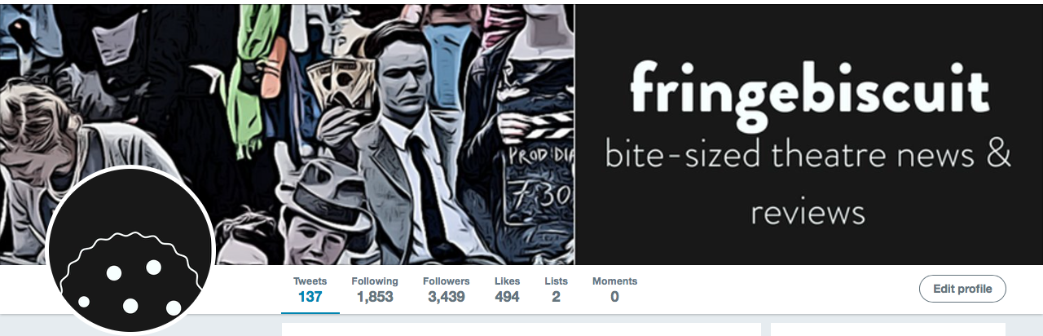
Background — Fringebiscuit
‘Bite-sized theatre news & reviews’
Founded 2010 with two aims:
Engage audiences with accessible critical writing
Provide training and opportunities for aspiring arts writers
Primary output via website (fringebiscuit.com) and Twitter (@fringebiscuit)

Slide 3
Overview — the ‘challenge’
Goals:
Use data from Twitter’s API to objectively assess the popularity of Edfringe 2018 shows.
Automate this analysis as far as possible to enable it to be updated regularly.
Present results in the public domain in as close to real-time as possible.
Constraints:
Budget — almost exactly £0.00...
Time — whatever could be mustered in between regular jobs!
Prior knowledge — not much! Data changed qualitatively and quantitatively at the same time as we had to make sense of it.

Slide 4
Real-time code development (data fights back…)
Best-laid plans
Reality

Slide 5
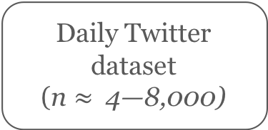
Overview — the approach
Twitter API
Edfringe website
Daily search query {rtweet}
edfringe
‘edinburgh fringe’
‘edinburgh festival’
intotheunknown
fringebiscuittrends
Daily Twitter dataset
(n $≈$ 4—8,000)
Web scrape {rvest}
Show Twitter handles & best-guess hashtags
(n = 3,847)
Tableau-generated web graphics
Matching routine
{stringr}
{tm}
Analysis and summaries
Daily-updated ‘show mentions’ dataset

Slide 6
Getting the data (1): Linking to Twitter’s API
Packages: Could use {twitteR} or {rtweet}, tried both. Ongoing maintenance/updates and support, plus much finer control, make {rtweet} the clear winner (https://rtweet.info)
Create a Twitter user account and a Twitter app (http://apps.twitter.com)
Authorise app in the console:

Slide 7
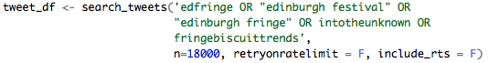
Getting the data (2): Making a query
Simple search function to make queries against the data stored in Twitter’s API
Boolean string to search, plus optional further search parameters
Constraints:
Maximum 18,000 tweets per 15 minutes
Maximum seven-day window
Search parameters get somewhat ‘squishy’ once they’ve been through the API — far better to go broad and refine later
Searching takes time — anything from 10 — 60 seconds per search
Returns data frame (tibble) with some nested list variables

Slide 8
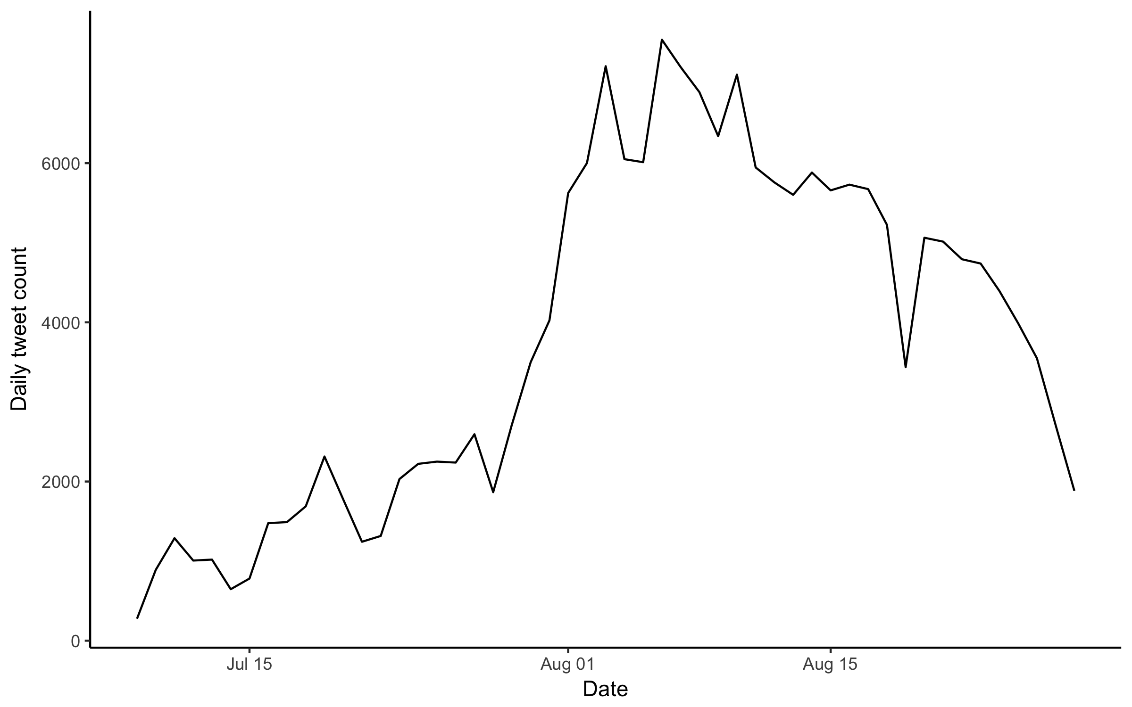
Detailed workflow: managing daily updates {dplyr}
Twitter API
Backup to cloud
Tableau Public
Master tweet dataset
Master tweet dataset
Daily tweet pull
Show scoring dataset
Sort chronologically
Grand total = 191,708 tweets
Filter to select complete days not yet published
Remove chronological overlap (but make sure it’s there!!)
Append to master dataset
Calculate new variables (sentiment + matching)
Matching routine

Slide 9
Matching tweet data to shows (1): Identifying show Twitter handles
Retrieved .csv file from Edfringe office giving all shows for the 2018 Fringe (n = 3,847), but… no Twitter handles!
Each show has a page on edfringe.com with performance details, including Twitter handle where the performer provides it (around 2 in 3).
Needed to retrieve > 2,000 Twitter handles — enter rvest!
Took the same opportunity to scrape show genres and sub-genres.
Show titles + guesswork to predict show URLs
Identify relevant html nodes (SelectorGadget)
Create map of html nodes for each page {rvest}
Search html nodes to find Twitter handles where present

Slide 10
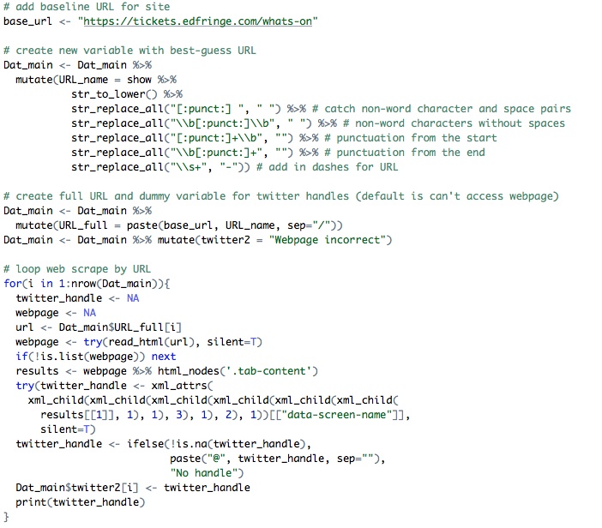
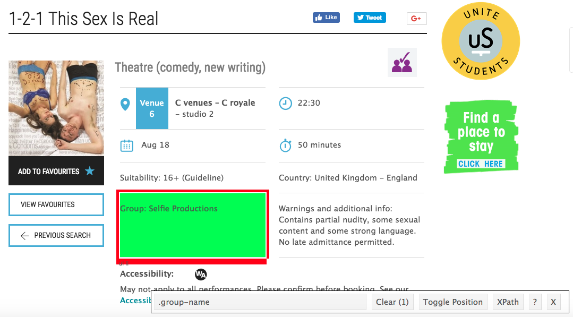
Show titles + guesswork to predict show URLs
Identify relevant html nodes (SelectorGadget)
Loop through URLs to retrieve html nodes for each page
Search html nodes to find Twitter handles where present

Slide 11
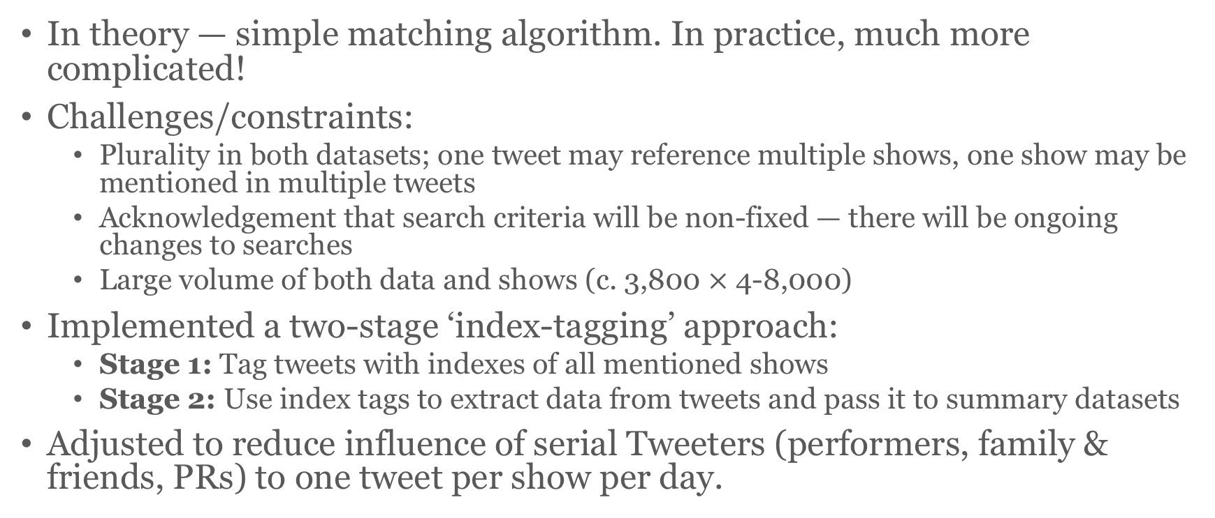
Matching tweet data to shows (2): Linking tweet mentions to show database
In theory — simple matching algorithm. In practice, much more complicated!
Challenges/constraints:
Plurality in both datasets; one tweet may reference multiple shows, one show may be mentioned in multiple tweets
Acknowledgement that search criteria will be non-fixed — there will be ongoing changes to searches
Large volume of both data and shows (c. 3,800 $×$ 4-8,000)
Implemented a two-stage ‘index-tagging’ approach:
Stage 1: Tag tweets with indexes of all mentioned shows
Stage 2: Use index tags to extract data from tweets and pass it to summary datasets
Adjusted to reduce influence of serial Tweeters (performers, family & friends, PRs) to one tweet per show per day.

Slide 12
Gathering data from tweets: mentions and sentiment analysis
Goal: simplistic and computationally non-intensive sentiment analysis of tweets
Presentable in intuitive, ‘one-glance’ visualisations
Settled on daily mentions and a measure of tweet sentiment
Could be improved with more time/analysis (and, crucially, Edfringe 2018’s tweet data)
Simple corpus with binary positive/negative classification (Ming & Liu, 2004). Derived from customer review analysis (appropriate?)
Clean tweet text of stopwords, punctuation, etc. {tm} {stringr}
Match positive and negative words in each tweet
Calculate metrics (n positive, n negative, net sentiment)
Minqing Hu and Bing Liu. "Mining and Summarizing Customer Reviews." ; Proceedings of the ACM SIGKDD International Conference on Knowledge ; Discovery and Data Mining (KDD-2004), Aug 22-25, 2004, Seattle, ; Washington, USA,

Slide 13
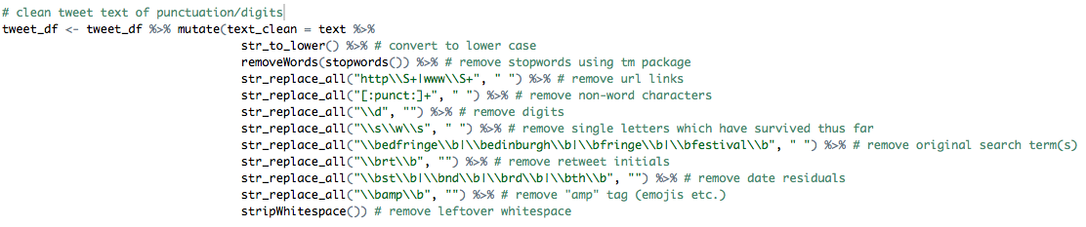
Sentiment analysis (1): Cleaning data
"@saltminetrust @edfringe Dearest Salters, we think our improvised Murder-Mystery might be just right! Every day, one lucky audience member chooses a new Killer and Victim - for a packed hour of fun, frolics and MURDER!\n\nTix: https://t.co/f3wEKzRpsp https://t.co/T1CJAshsvc"
"@MaisieAdam is fantastic. Her show is a highlight of this year's fringe. Warm, funny, sarcastic, with just the right amount of Yorkshire brio (and there is nothing wrong with Lytham St Annes)! #edfringe"
"Last night ended up being a heavy one. As such I've not yet tweeted about how excellent @NickDoody was! I've been wanting to see him for yonks and have only just got round to it... Did not disappoint! Proper fucking funny, amazing songs, top end of the bell curve stuff. #edfringe"
"We highly recommend checking out @seanmorl's surreal apology show 'I Apologise for My Recent Behaviour' at The Dragonfly 7.20pm. In turns humble and nightmarish, it is a true masterpiece of tension. It is also comedy! You'd be a fool to not attend! https://t.co/n7neEFpFgh"
"@JenBrister Jen - we saw your show at the beginning of #edfringe - we spoke v. briefly at the end & said how much we enjoyed your brilliant show. Sadly one always tends to remember the dough faced - guppy eyed - mouth breathers who make horrid comments. Jen erase them!you - were - amazing!"

Slide 14
Sentiment analysis (1): Cleaning data
" saltminetrust dearest salters think improvised murder mystery might just right every day one lucky audience member chooses new killer victim packed hour fun frolics murder tix "
" maisieadam fantastic show highlight year warm funny sarcastic just right amount yorkshire brio nothing wrong lytham annes "
" last night ended heavy one yet tweeted excellent nickdoody wanting see yonks just got round disappoint proper fucking funny amazing songs top end bell curve stuff "
" highly recommend checking seanmorl surreal apology show apologise recent behaviour dragonfly pm turns humble nightmarish true masterpiece tension also comedy fool attend "
" jenbrister jen saw show beginning spoke briefly end said much enjoyed brilliant show sadly one always tends remember dough faced guppy eyed mouth breathers make horrid comments jen erase amazing "

Slide 15
Sentiment analysis (2): Matching to corpus
" saltminetrust dearest salters think improvised murder mystery might just right every day one lucky audience member chooses new killer victim packed hour fun frolics murder tix "
" maisieadam fantastic show highlight year warm funny sarcastic just right amount yorkshire brio nothing wrong lytham annes "
" last night ended heavy one yet tweeted excellent nickdoody wanting see yonks just got round disappoint proper fucking funny amazing songs top end bell curve stuff "
" highly recommend checking seanmorl surreal apology show apologise recent behaviour dragonfly pm turns humble nightmarish true masterpiece tension also comedy fool attend "
" jenbrister jen saw show beginning spoke briefly end said much enjoyed brilliant show sadly one always tends remember dough faced guppy eyed mouth breathers make horrid comments jen erase amazing "

Slide 16
Many false negatives!
" saltminetrust dearest salters think improvised murder mystery might just right every day one lucky audience member chooses new killer victim packed hour fun frolics murder tix "
" maisieadam fantastic show highlight year warm funny sarcastic just right amount yorkshire brio nothing wrong lytham annes "
" last night ended heavy one yet tweeted excellent nickdoody wanting see yonks just got round disappoint proper fucking funny amazing songs top end bell curve stuff "
" highly recommend checking seanmorl surreal apology show apologise recent behaviour dragonfly pm turns humble nightmarish true masterpiece tension also comedy fool attend "
" jenbrister jen saw show beginning spoke briefly end said much enjoyed brilliant show sadly one always tends remember dough faced guppy eyed mouth breathers make horrid comments jen erase amazing "

Slide 17
Many false negatives!
" saltminetrust dearest salters think improvised murder mystery might just right every day one lucky audience member chooses new killer victim packed hour fun frolics murder tix "
" maisieadam fantastic show highlight year warm funny sarcastic just right amount yorkshire brio nothing wrong lytham annes "
" last night ended heavy one yet tweeted excellent nickdoody wanting see yonks just got round disappoint proper fucking funny amazing songs top end bell curve stuff "
" highly recommend checking seanmorl surreal apology show apologise recent behaviour dragonfly pm turns humble nightmarish true masterpiece tension also comedy fool attend "
" jenbrister jen saw show beginning spoke briefly end said much enjoyed brilliant show sadly one always tends remember dough faced guppy eyed mouth breathers make horrid comments jen erase amazing "

Slide 18
Many false negatives!
" saltminetrust dearest salters think improvised murder mystery might just right every day one lucky audience member chooses new killer victim packed hour fun frolics murder tix "
" maisieadam fantastic show highlight year warm funny sarcastic just right amount yorkshire brio nothing wrong lytham annes "
" last night ended heavy one yet tweeted excellent nickdoody wanting see yonks just got round disappoint proper fucking funny amazing songs top end bell curve stuff "
" highly recommend checking seanmorl surreal apology show apologise recent behaviour dragonfly pm turns humble nightmarish true masterpiece tension also comedy fool attend "
" jenbrister jen saw show beginning spoke briefly end said much enjoyed brilliant show sadly one always tends remember dough faced guppy eyed mouth breathers make horrid comments jen erase amazing "
… = “Positivity Score”

Slide 19
Alternative: Positivity score = zero
"Theatre preview: @joycemcm on Dogstar & Profilteatern’s high-energy climate change satire, Let’s Inherit the Earth. Read more at: https://t.co/gCezfZ53Ih @dogstartheatre @Profilteatern @edfringe"
"@Talldarkfriend @stephenkamos @edfringe See you there ❤️"
"Effing hell, just saw @JenBrister's show & howled with laughter. 1.45 at the monkey barrel. Go if you can. #edfringe"
"★★★★½ @MmmSausage: Regeneration Game | Monkey Barrel | Aug 9-26 | 12:00 | £5 - https://t.co/lEg18pFgmM"
"How can a comedian so young be able to mine so much uncomfortable material for his stage show from his own life? We chat to @Daniel_Sloss https://t.co/pjW49YqeBw"

Slide 20
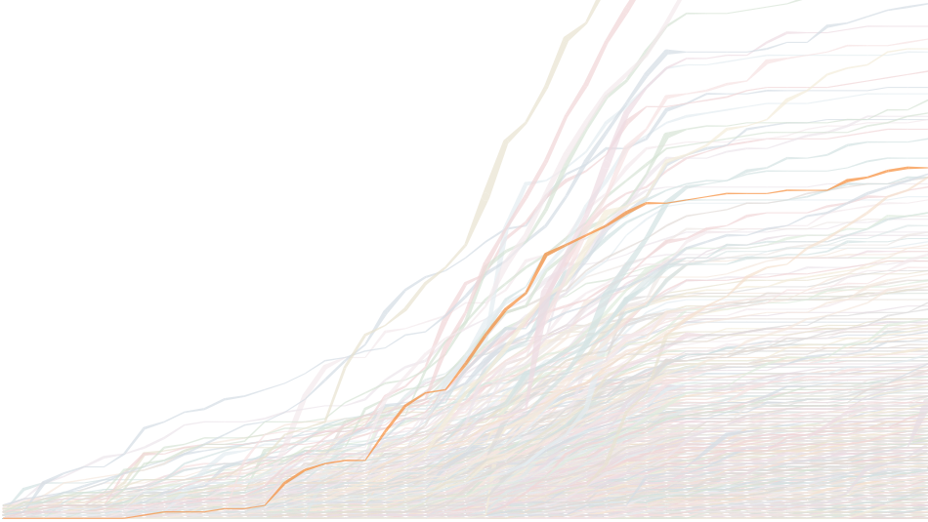
Results https://public.tableau.com/profile/alasdair.sykes

Slide 21
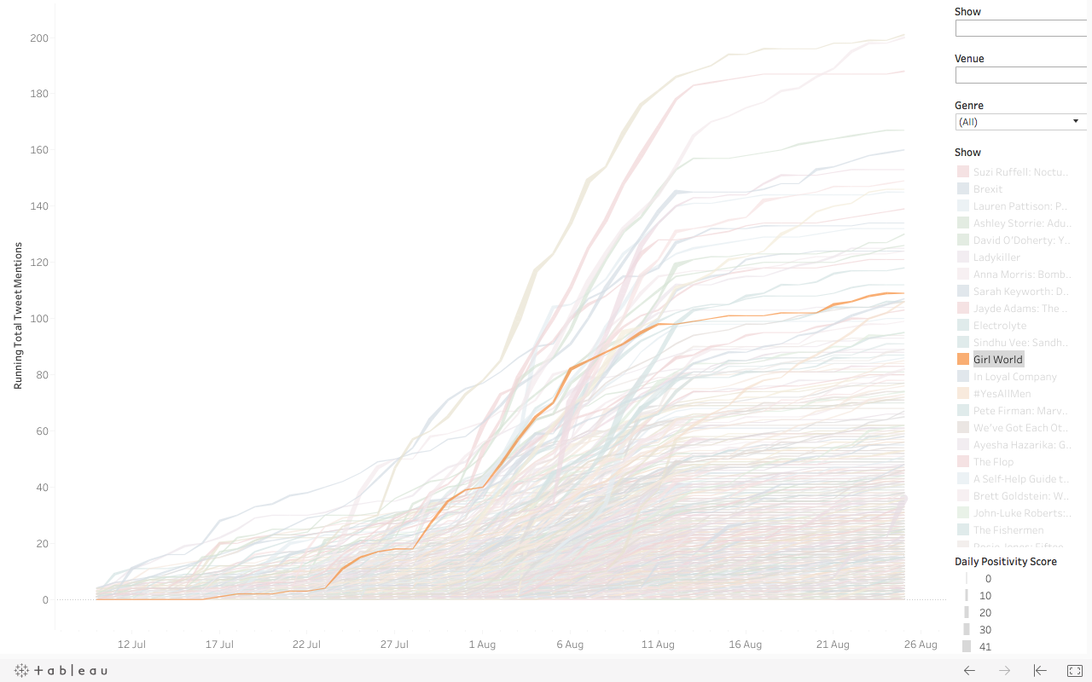
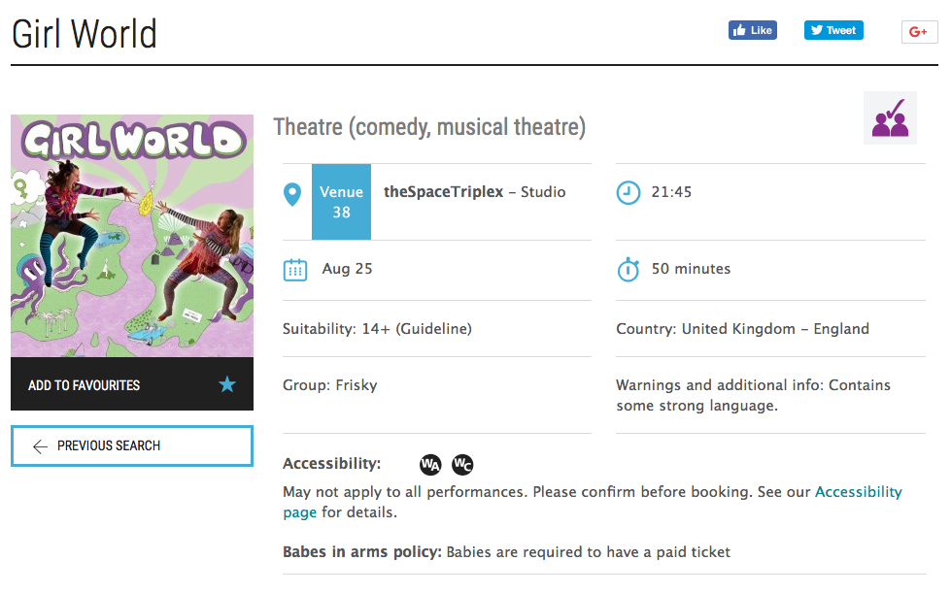
Case study: Girl World
Relatively unknown show — small, independent theatre company
Playing at theSpace (venue which focuses on smaller/up-and-coming artists)
Finished #21 (of 3,847) in our Fringe-wide mentions analysis
Ongoing Twitter analysis highlighted show and allowed our editor to a) review early and b) follow up with further contact
Girl World have now made contacts in USA through Fringebiscuit

Slide 22
Looking ahead: Edfringe 2019
Rewrite code to increase efficiency of certain elements:
Matching routine
Sentiment analysis
Implement lessons learned in matching criteria
Reduce budget and time constraints (AHRC funding)?
Explore other options for automation of visualisation (plotly, rShiny)
Involve stakeholders (venues, performers, Edfringe society)
Improve sentiment analysis and introduce other analysis (e.g. social network analysis)

Slide 23
Questions? alasdair.sykes@sruc.ac.uk | editorial@fringebiscuit.com

